Slide 1
Spring Security With JWT

Slide 2
Agenda
* Why we need to security In web application ?
* Authentication VS Authorization
*HTTP is stateless
* What is JWT ?
* JWT Structure
* What to take care of when dealing with JWT ?
* Registration Flow
* Generate Token Flow
* Validate Token Flow
*@PreAuthorize
* Demo

Slide 3


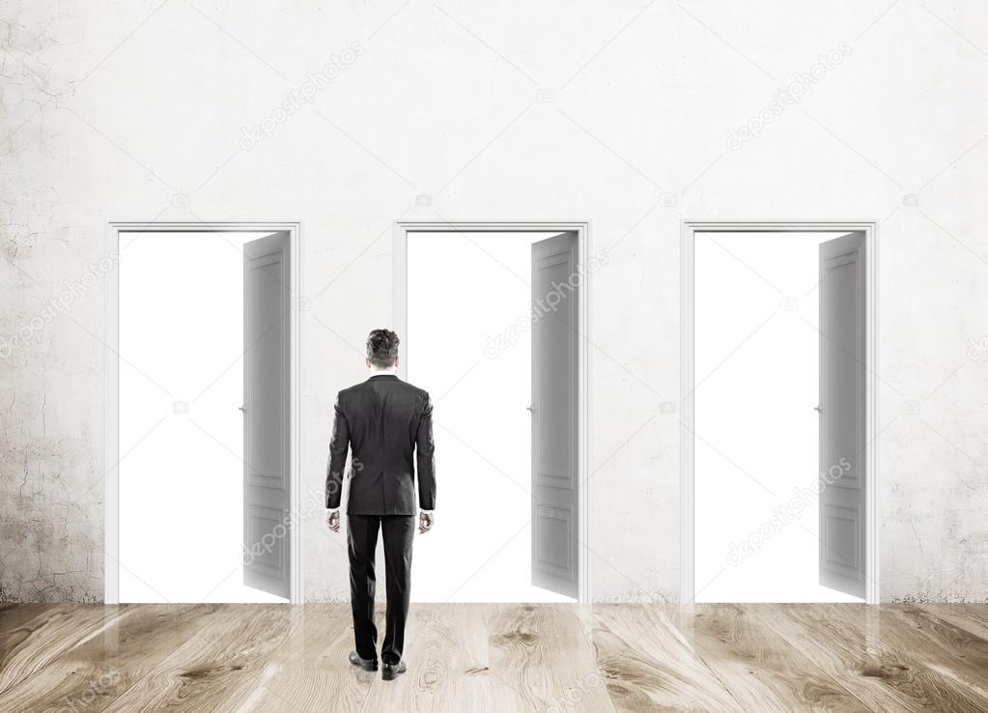
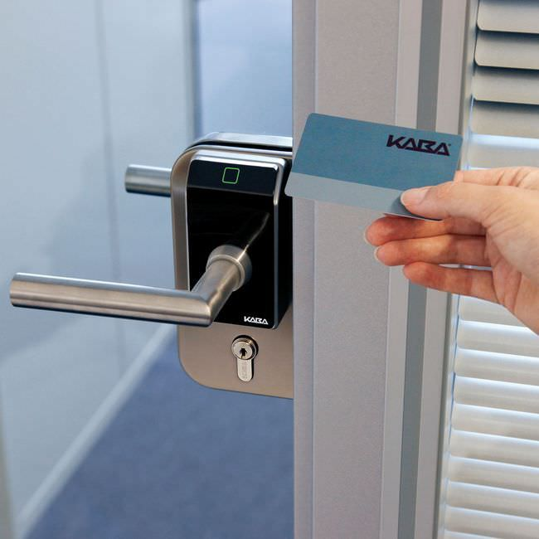
Why we need To security ?

Slide 4
Authentication VS Authorization
Who Are You ?
VS
What You have permission to do ?

Slide 5





Http Is Stateless
HTTP is a stateless protocol. A stateless protocol does not require the server to retain information or status about each user for the duration of multiple requests.
But some web applications may have to track the user's progress from page to page, for example when a web server is required to customize the content of a web page for a user.

Slide 6
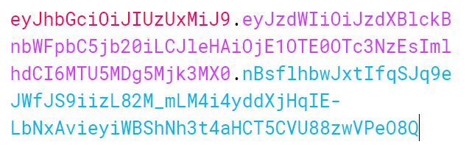
What is JWT ?
JWT Stands for Json Web Token .
Used For Authorization Purposes .
Act Like the ID of user in each request .

Slide 7
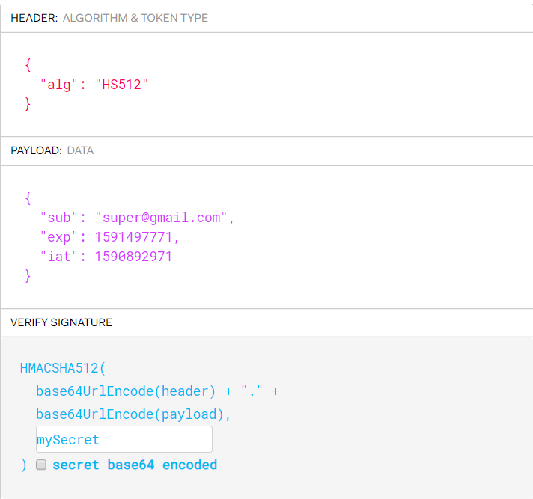
* JWT Structure
JWT have Three Parts .
Header
Payload
Signature

Slide 8
* What to take care of when dealing with JWT ?
No Confidential / Sensitive information in a JWT .
JWT Can be stolen by any one and it will be use so must be carful when you transmitting JWT for example use https .
How disable JWT ? Expiration in JWT , Blacklisted JWT .

Slide 9
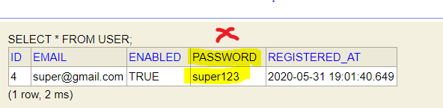
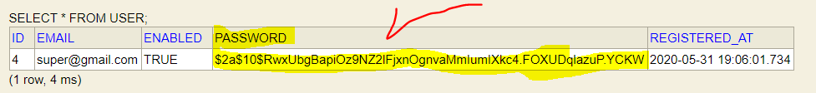
* Registration Flow
Get Username and Password From Client
Save It to Database
Use Hashing Helper Library To Hashing Password and Saving it as hashed value in DB .

Slide 10
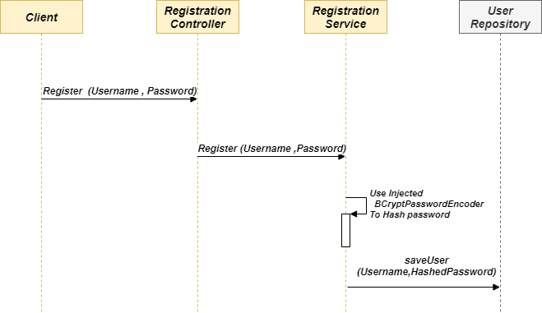
* Registration Flow

Slide 11
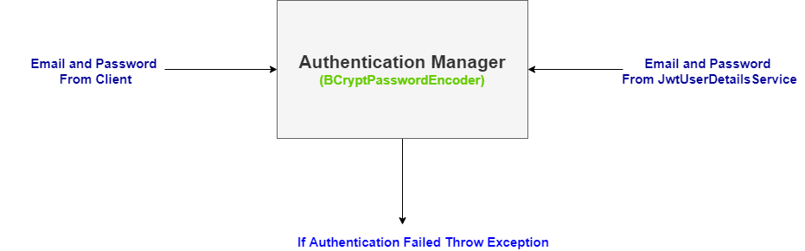
Authentication Manager

Slide 12
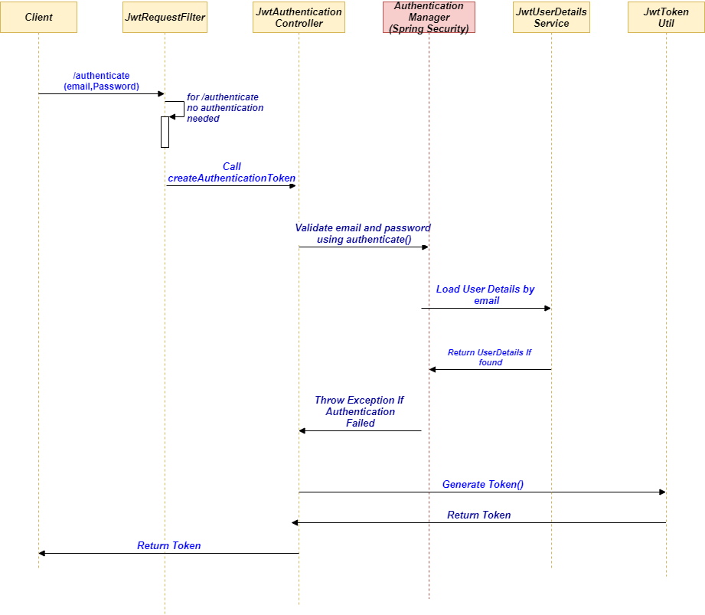
* Generate Token Flow

Slide 13
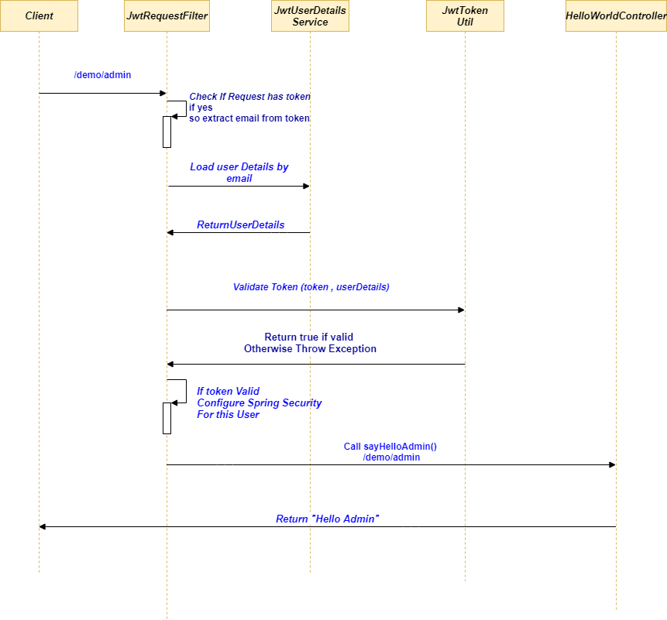
* Validate Token Flow

Slide 14
@PreAuthorize
So now our user Details In Spring Security Holder ( Holding His Role).
Let us just tell Spring to Authorize logged in user .
We can add to controller functions or service functions .
@PreAuthorize In Controller VS Service .

Slide 15
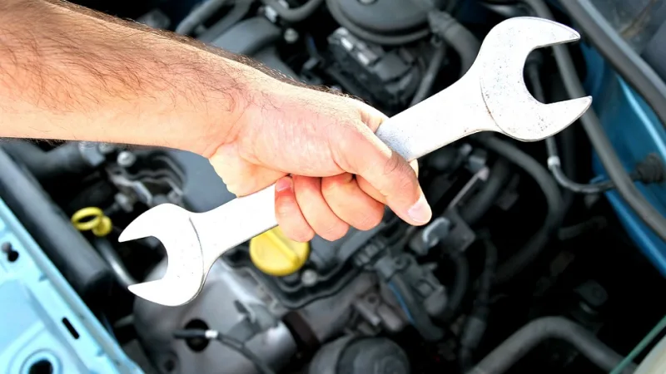
* Demo
Lets Get Hands Dirty !!

Slide 16
Questions
Thanks

